Slide 1

SignLang AI: Real-Time Sign Language Translator for Indian Sign Language
Presenter: Karthikey Parvathareddy

Slide 2
Presentation Outline
01
02
03
Introduction
The Core Challenge
Methodology
Defining the problem and our project's objectives.
Why most sign language models fail in the real world.
Our 4-stage development pipeline for success.
04
05
06
Step 1: Custom Dataset
Step 2: Data Preparation
Step 3: LSTM Model
Our solution to the core challenge.
Structuring the data for the AI.
Designing the "brain" of the project.
07
08
09
Step 4: Training & Results
Live Demonstration
Conclusion & Future Work
Training and validating the model.
Seeing the final application in action.
Key takeaways and next steps.

Slide 3
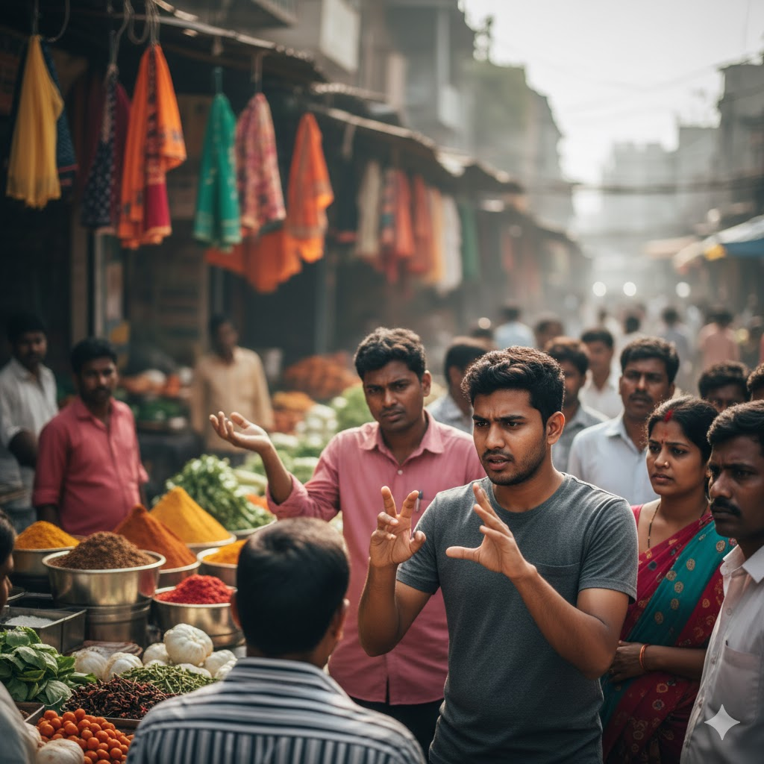
The Problem: A Critical Communication Barrier
In India, millions rely on Indian Sign Language (ISL), yet a significant communication barrier isolates this community from the hearing majority, impacting access to education, healthcare, and public services.
While AI seems a clear solution, most projects fail when deployed due to "Domain Mismatch." Models trained on "clean" studio datasets struggle with real-world conditions like variable lighting, backgrounds, and unique hand shapes from a standard webcam.
Our project specifically addresses this real-world problem.

Slide 4

The Solution: A Unified, Custom Dataset
Our key innovation was creating a single, unified dataset recorded entirely on the target webcam. This eliminates "domain mismatch" by training the model on the exact data it will encounter in the real world.
47 Distinct Classes
36 Static Signs
11 Dynamic Signs
50 samples each, ensuring comprehensive coverage.
Numbers 0-9 and Alphabet A-Z, held for 60 frames.
Words like Hello, Goodbye, Thanks, and a critical 'idle' class.

Slide 5

Project Objectives & Scope
Out of Scope (What this project is not):
Primary Objective
A User-Independent ("universal") model, requiring data from hundreds of users.
To design, build, and train a high-accuracy, real-time classifier for a 47-class ISL vocabulary, capable of recognizing both static and dynamic gestures.
A Full Sentence Translator, as this system does not interpret ISL grammar.
In Scope (What this project is):
A User-Dependent system, optimised for the user who recorded the data.
An Isolated Sign Classifier, recognising one sign at a time.
A Proof-of-Concept running on a standard CPU.

Slide 6
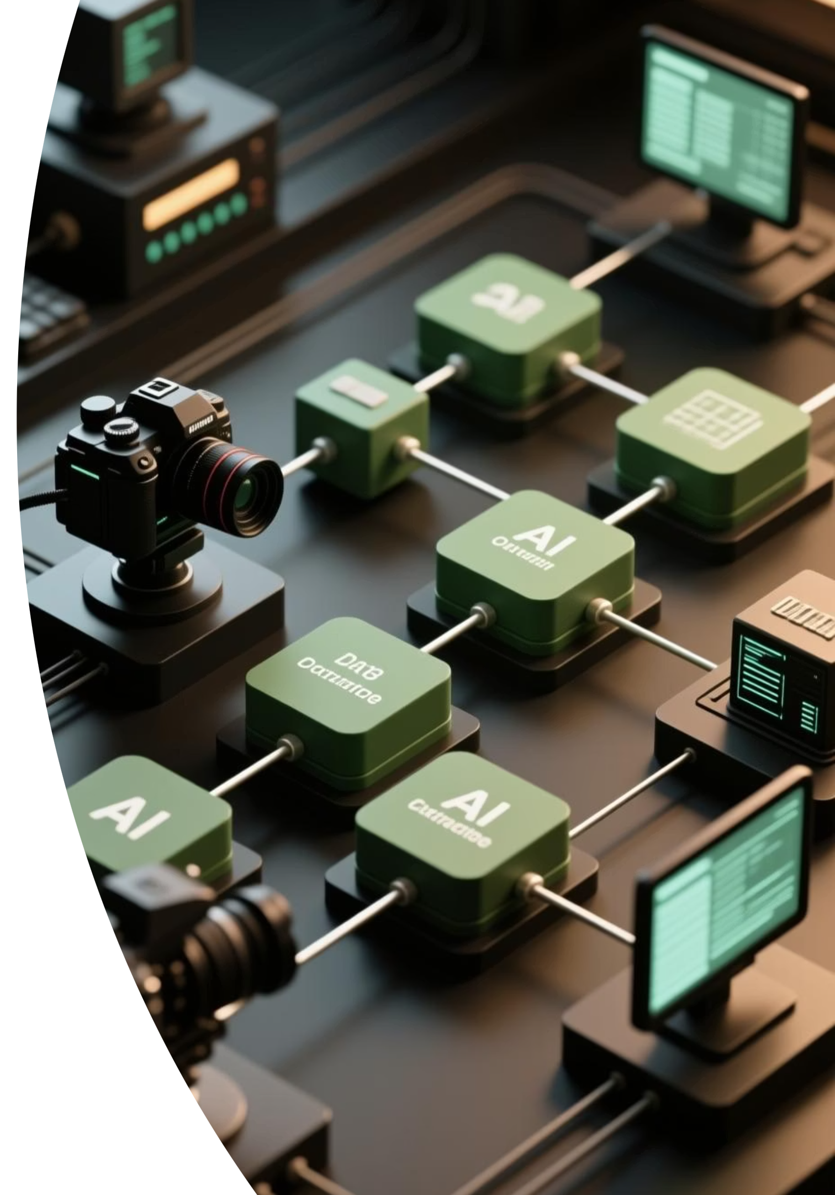




System Architecture: A 4-Stage Pipeline
Our system operates in a continuous, real-time loop, with each webcam frame passing through this 4-stage pipeline.
1. Capture (OpenCV)
Webcam captures a single video frame.
2. Extract (MediaPipe)
MediaPipe's "Holistic" model detects 21 3D landmarks for each hand, creating a 126-coordinate vector.
3. Classify (LSTM Model)
The 126-point vector is added to a 60-frame sequence buffer, fed into the trained LSTM model to predict one of 47 classes.
4. Display (OpenCV)
The most confident prediction (e.g., "Hello") is drawn onto the screen.

Slide 7






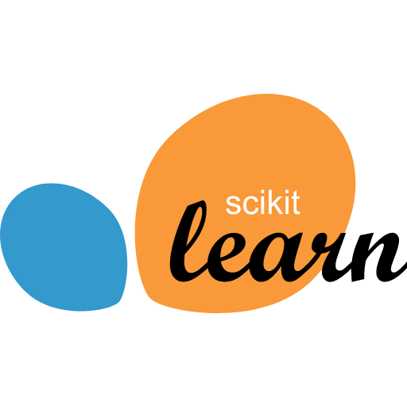
Technology Stack
This project was built using a specific, stable set of powerful and efficient open-source libraries.
Python 3.10
OpenCV
Core programming language for all scripts.
Real-time video I/O, webcam capture, image processing, and display.
MediaPipe
TensorFlow & Keras
High-performance Google framework for fast and accurate hand landmark detection.
Deep learning framework for designing, compiling, training, and saving our LSTM neural network.
NumPy
Scikit-learn
Fundamental library for numerical operations, creating and processing landmark data arrays.
Used for the train_test_split function to create training and testing datasets.

Slide 8
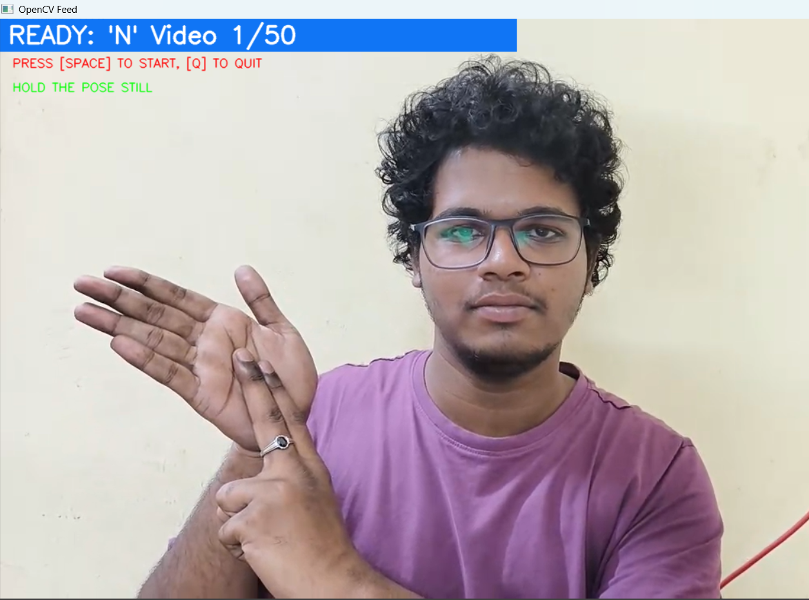
Step 1: Data Collection
We created a custom data collection script with several key features to ensure a
high-quality dataset.
Class Selection Menu: Allowed starting, stopping, and resuming recording for any of the 47 classes.
On-Screen Guidance: Displayed "HOLD THE POSE" for static signs and "DO THE MOTION" for dynamic signs, ensuring data consistency.
2-Second Countdown: Gave the user time to get in position before recording began.
We recorded 50 samples for each of the 47 classes. Each sample was a 60-frame sequence, resulting in 2,350 total .npy files (47 classes * 50 samples).

Slide 9

Step 2: Data Preparation
This script prepared the 2,350 raw .npy files for the AI.
1
2
Load & Label
One-Hot Encode
Loaded all 2,350 (60, 126) arrays and assigned a numerical label (0-46) to each based on its folder name.
Numerical labels converted to a "categorical" format (e.g., label 2 ('B') became a 47-element vector: [0, 0, 1, 0, ... 0]), as required by the model.
3
Split Data
Dataset split into 80% Training Set (1880 samples) and 20% Testing Set (470 samples). stratify=y ensured fair representation of all 47 classes.

Slide 10
Step 3: The Deep Learning "Brain"
We designed a Stacked Long Short-Term Memory (LSTM) network, ideal for understanding time-series data by "remembering" the entire 60-frame motion.
1
Input Layer
Expects a (60, 126) shape (60 frames, 126 features).
2
LSTM Layer 1 (64 units)
Learns basic, short-term patterns; return_sequences=True.
3
LSTM Layer 2 (128 units)
Learns more complex patterns; return_sequences=True.
4
LSTM Layer 3 (64 units)
return_sequences=False outputs a single vector summarising the 60-frame gesture.
5
Dense Layers (64 units)
Standard processing layer.
6
Output Layer (47 units)
Softmax layer outputs probability for each of 47 classes.
Dropout and BatchNormalization layers were added to prevent overfitting and stabilise training.

Slide 11
Step 4: Model Training & Tuning
The model was compiled and trained with specific hyperparameters for stability and accuracy.
Optimizer: Adam
Learning Rate: 0.0001 (or 1e-4)
Callback: EarlyStopping (patience=20)
A standard optimizer used for deep learning models.
A standard learning rate (0.001) was too high and caused the model's loss to "explode." By using a small, stable rate, we ensured the model learned consistently.
This was our most important tool. It monitored the model's accuracy on the test data at every epoch. If the accuracy didn't improve for 20 epochs, it stopped training and, crucially, restore_best_weights=True automatically loaded the model from its best-performing epoch.

Slide 12
Results: A 99.15% Accurate Model
Our methodology was a complete success, validated by the training results.
99.15%
466
82
Peak Accuracy
Correct Samples
Optimal Epoch
on the unseen 20% test dataset.
out of 470 test samples identified correctly.
Peak performance reached. Model saved by EarlyStopping.
The training and validation accuracy graphs converged almost perfectly, proving our unified dataset solved the "domain mismatch" problem and that the model is extremely robust.

Slide 13

Live Demonstration
We will now run the test_realtime.py script to see the final model in action.
This application loads our sign_classifier_model.keras file and makes live predictions on the webcam feed.
Static Signs (A, B, C...)
Dynamic Signs (Hello, Thanks)
The idle Class
The model will instantly recognize the held poses.
The model will recognize the motion as it's being performed.
When I put my hands down, the prediction text disappears. This "nothing" class is working, preventing constant false predictions.

Slide 14
Conclusion & Limitations
Conclusion
Limitations
We successfully built a 99.15% accurate, real-time classifier for 47 ISL signs. The key to this success was creating a unified, custom dataset, which completely solved the "domain mismatch" problem. This project serves as a robust proof-of-concept for a user-specific translation tool.
User-Dependent: The model is tuned only to my hands and my camera.
Classifier, Not Translator: It recognizes isolated signs, not full sentences or grammar.
Limited Vocabulary: 47 classes is a small fraction of the full ISL language.

Slide 15
Future Work
This project provides a strong foundation for several key enhancements.
1
2
3
Fingerspelling-to-Word Module
User-Independent Model
Model Optimization (GRU)
Implement logic to buffer the static letter predictions (e.g., 'H', 'I') and use a "space" sign to combine them into a single word ("HI") on the screen.
The most important next step. This would involve collecting data from 100+ different people to build a "general" model that works for everyone.
The LSTM model is accurate but computationally heavy. It could be replaced with GRU (Gated Recurrent Unit) layers, which are much faster and should provide similar accuracy, improving the real-time FPS.

Slide 16
Thank You
Questions?

